Slide 1
Om Prakash
RCA, Solution Architect.

Slide 2
Vision
Continuous and very close engagement with enterprise team, Product management and release train to build a cohesive synergy to design, and implement a consistent, reliable, resilient, sustainable, robust futuristic architectural runway to enable fast delivery of value to the customer.

Slide 3
Goal
To play game changer role in empowering a sustainable, value-based healthcare delivery and payment system with data services, analytics and advanced technologies that inform smarter business decisions and reduce risk.

Slide 4
Why me
I have 18+ year of professional experience in the field of IT with experience in problem solving, designing, development and implementation of small to complex software systems. Successfully developed projects on various technical platforms and in different functional domains.
I have successfully rollout large corporate initiatives like Automation, ETL, Micro service architecture, SPA, CICD, Test automation, Source control and Container deployment in big company like Comcast, SEI, American Express .
I have 2+ year of experience in Cotiviti and well aware of the Cotiviti work culture and hand on experience with most of the RCA applications. I know most of the team members of Enterprise architecture team and will be easy for me to jump start without wasting anytime.
The most important value is, I am very quick learner and always ready to go extra miles to not just meet the expectation but to exceed the expectation and very firm believer of “Nothing will change unless you want to change it, so lead the change from front and challenge the status quo”

Slide 5
Role & Team Responsibility
Moving Forward
Previously
Charlie Bachetti
Om Prakash
Legacy Platform
COB
Legacy Platform
Post ID
Charlie Bachetti
Om Prakash
New Platform
Ark, Cyclone
Legacy Platform
Pri ID, Post ID
Spring Zhou
New Platform
Pri ID, Ark

Slide 6
Certifications
Certified SAFe 5 Architect
SAFe 4 Practitioner
Certified SAFe 5 Agilist
Certified Scrum Master
Certified SAFe 5 Scrum Master
Azure Solutions Architect
Project Management Professional (PMP)

Slide 7
Lead the team…………..
In order to deliver value quicker, we must align to the need of release trains and support them on timely. Continuous engagement will help to build a partnership in value delivery to client.
We should make the decisions on architecture runway quickly and communicate with the release train in advance.
We should not engage in delivery of day today business needs rather than long term business need and platform level improvement, alignment, security, automation, application eco system consistency across the release team.
Enterprise architecture team should have a team of contractors under them in order to delivery NFR on time to release trains. We should not be using the release train capacity to deliver our products/vision, they should be focused on client request and work on client priority.
We should participate in PI planning and system demo of release trains to get better understanding of what team is delivering and planning to deliver.

Slide 8
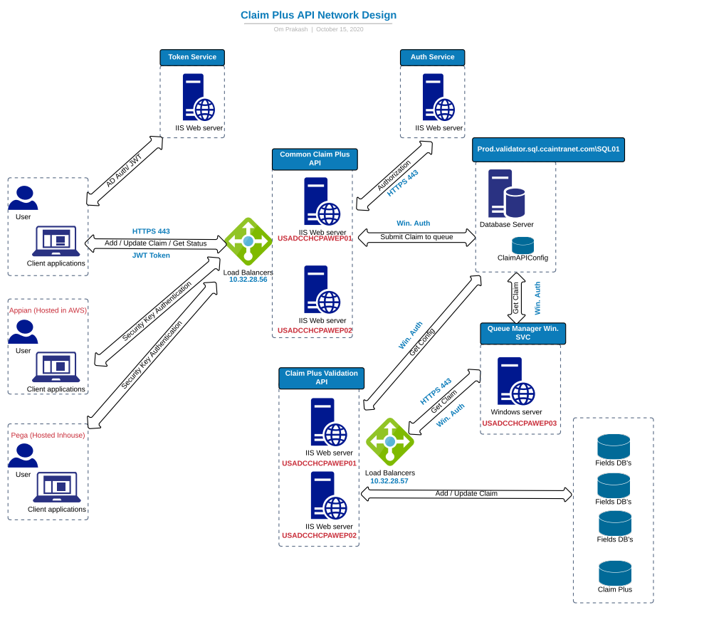
Claim API

Slide 9
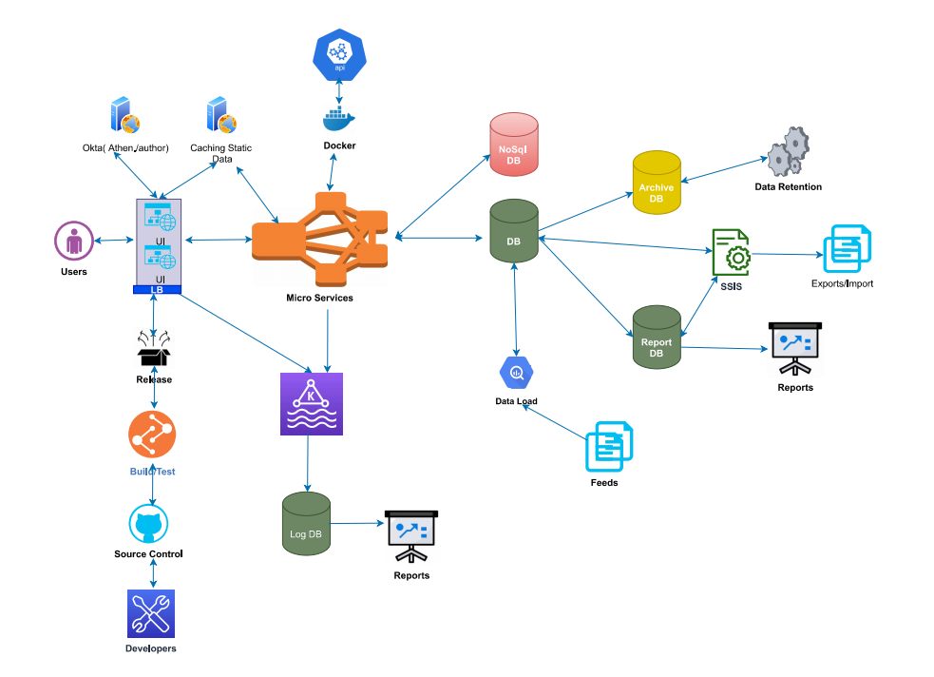
Vision of Ideal Platform

Slide 10
Achievement in RCA
Implemented first Micro service in .Net Core
Integrated SonarQube scan in Bamboo
Implemented first Angular application
Implemented Data Retention project for IG team
Implemented first CICD pipeline for Claim API
Configured Micro service in Load Balancer
Implemented first DB CICD using Bamboo & Octopus
Implemented Token & Authorization Micro Service

